Slide 1
Adopting Worst-Case Optimal Joins in Relational Database Systems
Written by Michael Freitag, Maximilian Bandle, Tobias Schmidt, Alfons Kemper, and Thomas Neumann
Presented by Jeremy Robichaud and Mohammadali Rahnama

Slide 2
Problem

Slide 3
Given Q∆ := R1(v1, v2) ⋈ R2(v2, v3) ⋈ R3(v3, v1), and R1=R2=R3
What is the problem?
Would operate R1 ⋈ R2, then construct R12 ⋈ R3.
The intermediate step R12, will be much larger than the resultant query.
Total order of O(e²) but O(e^{1.5}) triangles, where e are the edges.

Slide 4
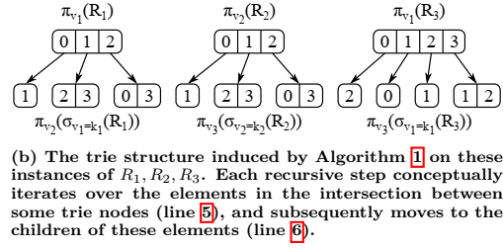
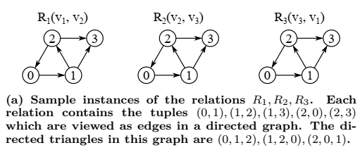
What is Worst-Case Optimal Joins?
It’s a join operation that process multiple input relations in a single multi-way join.
multi-way joins avoid enumerating any potentially exploding intermediate results
Existing implementations require suitable ordered index structure.
They engineered worst-case optimal join algorithm that is hashbased instead of comparison-based and thus does not require any precomputed ordered indexes

Slide 5
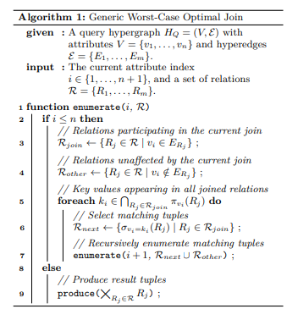
Algorithm 1
It operates on the query hypergraph HQ = (V, E) of a query Q, where the vertex set V contains the attributes {v1, . . . , vn} of Q, and the edge set E = {Ej | j = 1, . . . , m} contains the attribute sets of the individual relations Rj . In case of our running example Q∆, the query hypergraph is given by V = {v1, v2, v3} and E = {E1, E2, E3} with E1 = {v1, v2}, E2 = {v2, v3}, E3 = {v1, v3}.
Algorithm 1 consists of a recursive function which searches for valid assignments of a single join key vi in each recursive step. The index i of the current join key is passed as a parameter to the algorithm. In later recursive steps (i.e. i > 1), the backtracking nature of the algorithm entails that a specific assignment for the join keys v1, . . . , vi−1 has already been selected in the previous recursive steps (see above). The second parameter R consists of m separate sets, one for each input relation Rj , which contains all tuples from Rj that match this specific assignment of join key values. Initially, i is set to 1 and R contains the full relations Rj .
Within a given recursive step i, the algorithm first determines which relations contain the join key vi and thus have to be considered when searching for matching assignments of vi (line 3). These relations are collected as separate elements in the set Rjoin. Next, the algorithm iterates over all assignments ki of vi that appear in every one of these relations (line 5). In every iteration of this loop, the tuples that match the current assignment ki of vi are selected from the relations in Rjoin (line 6) and the algorithm proceeds to the next recursive step (line 7). In the final recursive step (i.e. i = n + 1), the relations in R contain only tuples that match one specific assignment of the join keys and are thus part of the query result (line 9).
O(nm П _{Ej∈E} |Rj |^{xj} )

Slide 6
Implementation
The proposed join processing approach can be split into clearly separated build and probe phases.
In the build phase the input relations are materialized, and the corresponding hash tries are created.
In the subsequent probe phase, the worst-case optimal hash trie join algorithm utilizes these index structures to enumerate the join result.

Slide 7
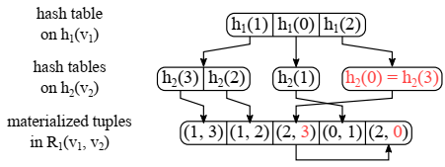
Hash Tries
3.2.1 – Why its important
A hash trie represents a prefix tree on the hashed join attribute values of a relation, where the join attributes and their order are determined by a given query hypergraph.
We apply two further optimizations to the hash trie data structure, namely singleton pruning and lazy child expansion Singleton pruning compresses paths in which every node has exactly one child
3.3.1 – How it’s implemented

Slide 8
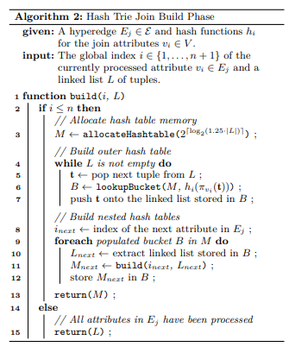
Build Phase
3.2.2
3.3.2

Slide 9
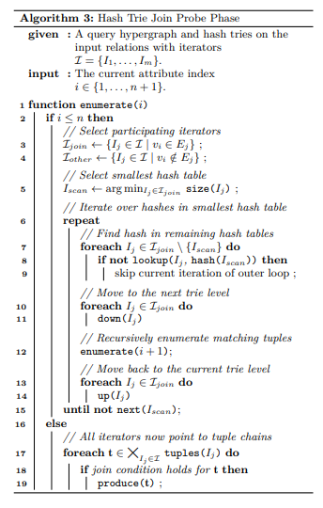
Probe Phase
3.2.3
3.3.3

Slide 10
Complexity Analysis
3.2.4

Slide 11
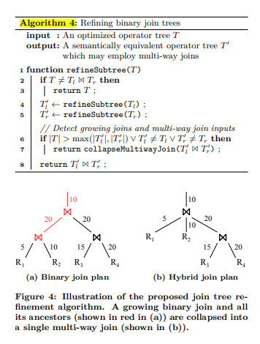
Optimizing Hybrid
4.0
Since Worst-Case Optimal CAN BE slower than binary than a general-purpose system can replace all binary queries.
Hybrid approach, using recursive post-order traversal to optimize and decide whether to replace a binary join with the multi-join.

Slide 12
Results

Slide 13
Umbra= Umbra version of binary join
Umbra^{EAG}= Umbra version of multi-join
Umbra^{OHT}= Umbra version of their hybrid join

Slide 14
Conclusion
7.0

